Slide 1
Numerical Solutions Lab — Series 1
e and ln(a) seen through three limits: compound interest, difference quotients, Taylor series
Python + NumPy + Matplotlib · figures recreated from Series1.pdf

Slide 2
What the laboratory sheet asks
Exercise 1
(1 + 1/n)^n — compound-interest table “up to nanosecond” → e = 2.718282
Exercise 2
(a^h − 1)/h for a = 2, e, 3 as h shrinks → settles at ln(a)
Exercise 3
e^x = Σ x^n/n! (x = 1) up to N = 10,000 terms → e
Each exercise: implement → print the limit table → draw a Matplotlib histogram.

Slide 3
The concept behind the series: the number e
Continuous compounding
e = lim (1 + 1/n)^n. One formula, three faces: interest paid yearly, monthly, …, continuously.
Derivative of an exponential
lim (a^h − 1)/h = ln(a); with a = e the limit is 1 — e is the base whose slope at 0 equals 1.
Taylor series
e^x = Σ x^n/n!; at x = 1 the partial sums converge to e — about one new correct digit per term.
Why it matters numerically
Same limit, different convergence speeds and different floating-point behaviour (e/(2n), (ln a)^2 h/2, e/(N+1)!). The lab shows limits are approximations until you add the error term.

Slide 4
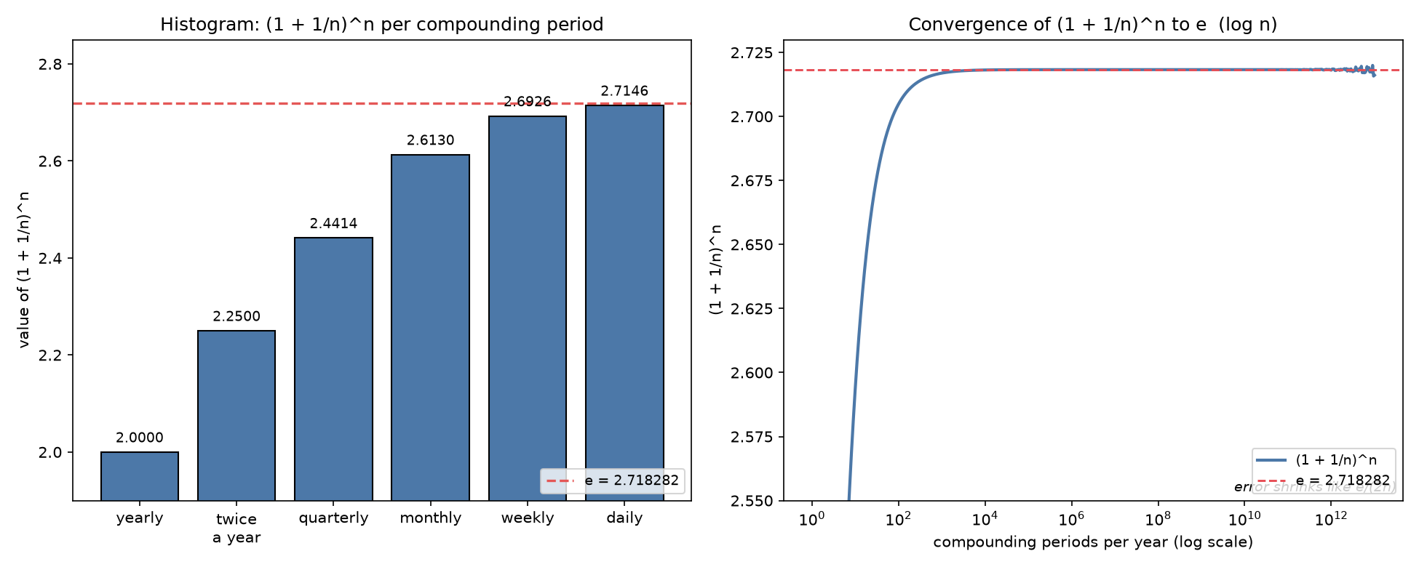
Exercise 1 — Compound interest: (1 + 1/n)^n → e
• Table of the sheet: yearly 2.000000, twice a year 2.250000, quarterly 2.441406 (= (1+1/n)^n).
• Extension “up to nanosecond”: n = 12, 52, 365, … 3.15×10^16; the sequence climbs to 2.718282 = e.
• Error analysis: (1 + 1/n)^n = e(1 − 1/2n + …) ⇒ |e − value| ≈ e/(2n).
• Histogram + log-n curve drawn with Matplotlib (figure 1).
ANSWER: limits to e = 2.718281828…
Caveat: at n > 2^53 ≈ 9×10^15, 1 + 1/n rounds to 1 in float64 — the “nanosecond” row returns 1.0.
Figure 1 — histogram of (1+1/n)^n; right: convergence curve on log n with the e-line.

Slide 5
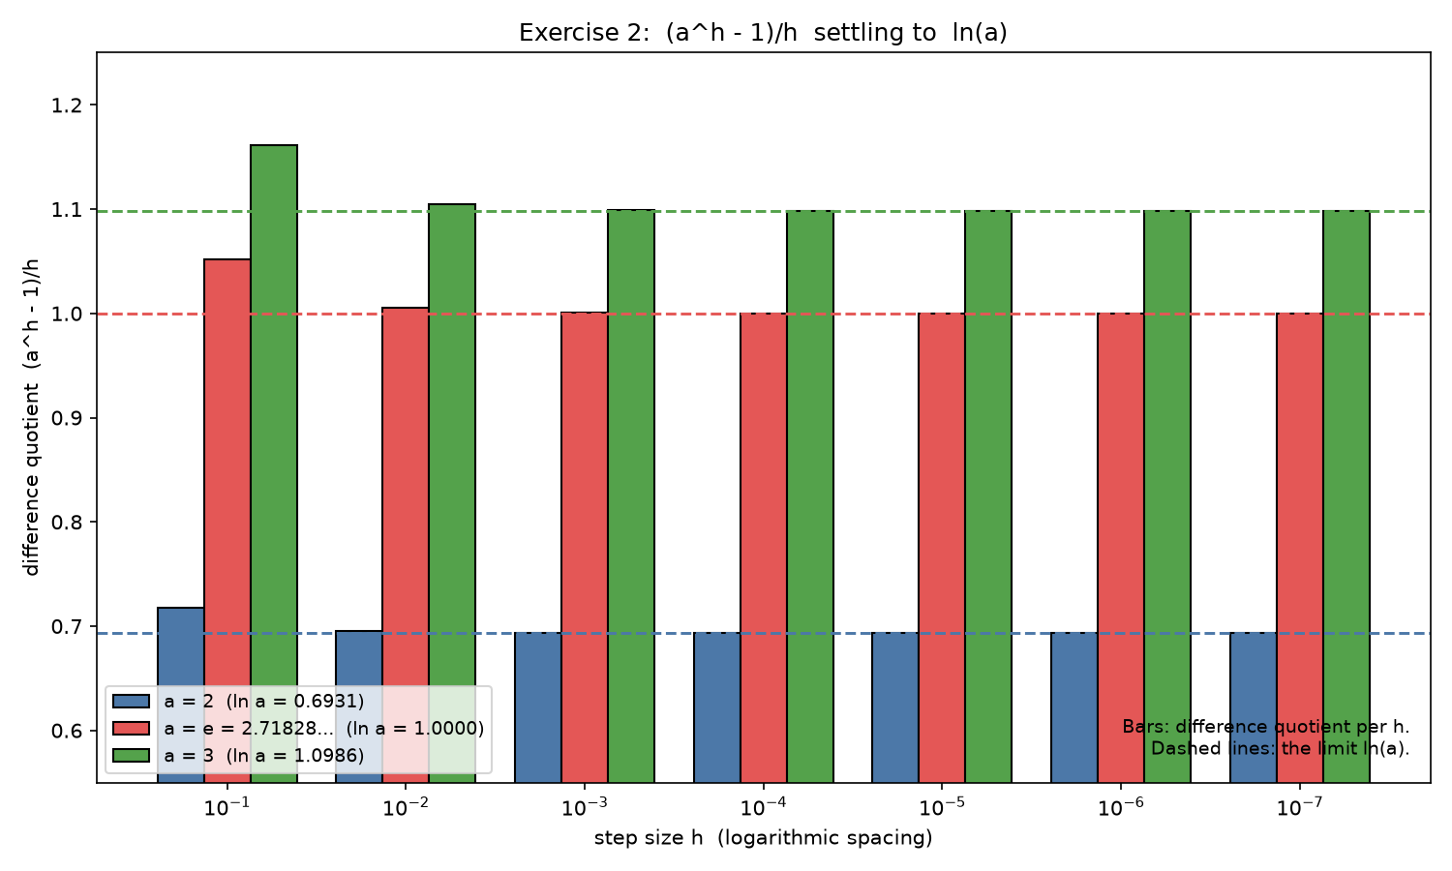
Exercise 2 — Difference quotient: (a^h − 1)/h → ln(a)
• (a^h − 1)/h = ln(a) + (ln a)^2 h/2 + … → ln(a).
• h = 0.1, 0.01, 0.001, 0.0001, … 1e-7 (Tolerance 1e-6).
• No sums needed — just pow() and division; each column “settles at” its logarithm.
ANSWER TABLE (matches the sheet):
h a=2 a=e a=3
0.1 0.7177 1.0517 1.1612
0.01 0.6956 1.0050 1.1047
0.001 0.6934 1.0005 1.0992
0.0001 0.6932 1.00005 1.0987
settles at 0.693147 1.000000 1.098612
Figure 2 — bars = quotient per h; dashed lines = ln(a) for a = 2, e, 3.

Slide 6
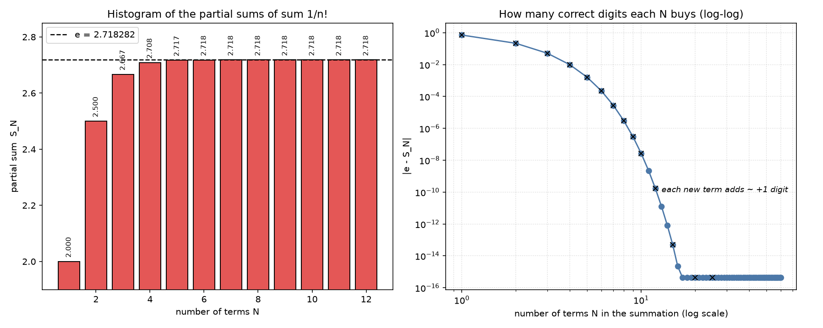
Exercise 3 — Taylor series: e^x = Σ x^n/n! (x = 1)
• e^x = Σ x^n/n! with x = 1, N up to 10,000; recurrence term ← term·x/n (no huge factorials).
• Partial sums: N=3 → 2.666667, N=6 → 2.718055, N=9 → 2.7182815, N=12 → 2.7182818282.
• Every term adds ~1 correct digit: error ≈ e/(N+1)!.
• Double precision exhausted by N ≈ 20–40; the rest up to 10,000 changes nothing.
ANSWER: converges to e = 2.718281828459045…
Histogram of partial sums + log-log plot of |e − S_N| (figure 3).
Figure 3 — left: histogram of partial sums; right: correct digits per N on a log-log scale.

Slide 7
Answers at a glance
Exercise 1 — (1 + 1/n)^n (n = 1, 2, 4, … → up to nanosecond)
2.000000 / 2.250000 / 2.441406 → e = 2.718282 (error = e/(2n); float64 breaks at 2^53)
Exercise 2 — (a^h − 1)/h (a = 2, e, 3 ; h = 0.1 → 1e-7)
0.7177… 1.0517… 1.1612… → ln a = 0.6931 / 1.0000 / 1.0986 within 1e-6
Exercise 3 — Σ x^n/n!, x = 1 (N up to 10,000)
S_N → e; |e − S_N| ≈ e/(N+1)!; machine precision by N ≈ 20–40
Conclusion: three different formulas, the same limit — e.

Slide 8
Files delivered
series1_ex1.py → figure1_compound_interest.png
series1_ex2.py → figure2_difference_quotient.png
series1_ex3.py → figure3_taylor_series.png
dashboard.html → interactive results dashboard
series1_presentation.pptx → this presentation
Series1.pdf → original laboratory sheet
Thank you — questions?

